Slide 1
MONEY-TRACK+
BY:-
NAME | REGISYTRATION NO.
ARCHIT JAIN | RA2211003030138
AYUSH GUPTA | RA2211003030205
MEGHA GUPTA | RA2211003030302

Slide 2

AGENDA
This project mainly FOCUSES ON HELPIING INDIVIDUALS TO KEEP A TRACK ON THEIR EXPENSES SMARTLY AND HELPS THEM TO SAVE MONEY EFFICIENTLY.

Slide 3

INTRODUCTION
MONEY-TRACK+ is an easy and efficient budget app for managing your money.It is an expense tracker app which helps to plan your budget effectively and efficiently. It records your daily expenses ,determine your savings and represents your data in a pictorial form.

Slide 4
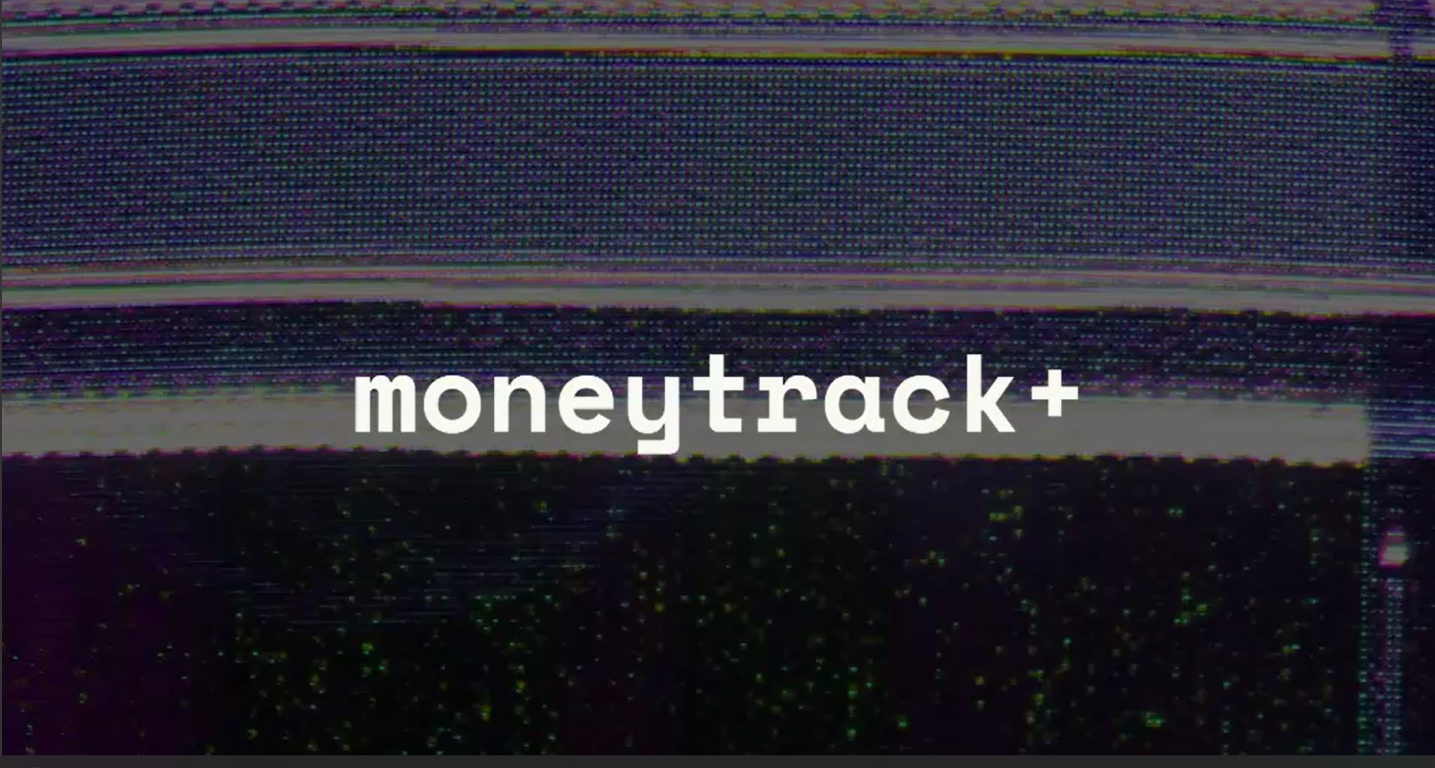
FEATURES
BUDGET HANDLING :
Users can set up their budgets for different categories of expenses such as travels , food ,education , maintainence and others and keep a track on their expenses.
CUSTOMIZED RECOMMENDATION :
Users experience an exclusive feature of receiving alerts whenever they exceed their set limits and gets suggestions on how can they cut down their experiences.
GOAL SETTING :
Users can set their goals according to their needs like how much should they spend monthly and annually.

Slide 5
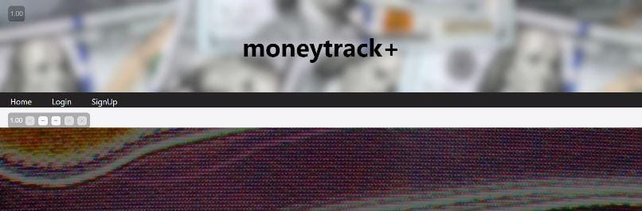



Here ,we are taking an example to show how the Money-track+ is going to work.
For instance,this will be our homepage for Money-Track+.
This is our homepage
This will be used for signing up
This is used for login

Slide 6
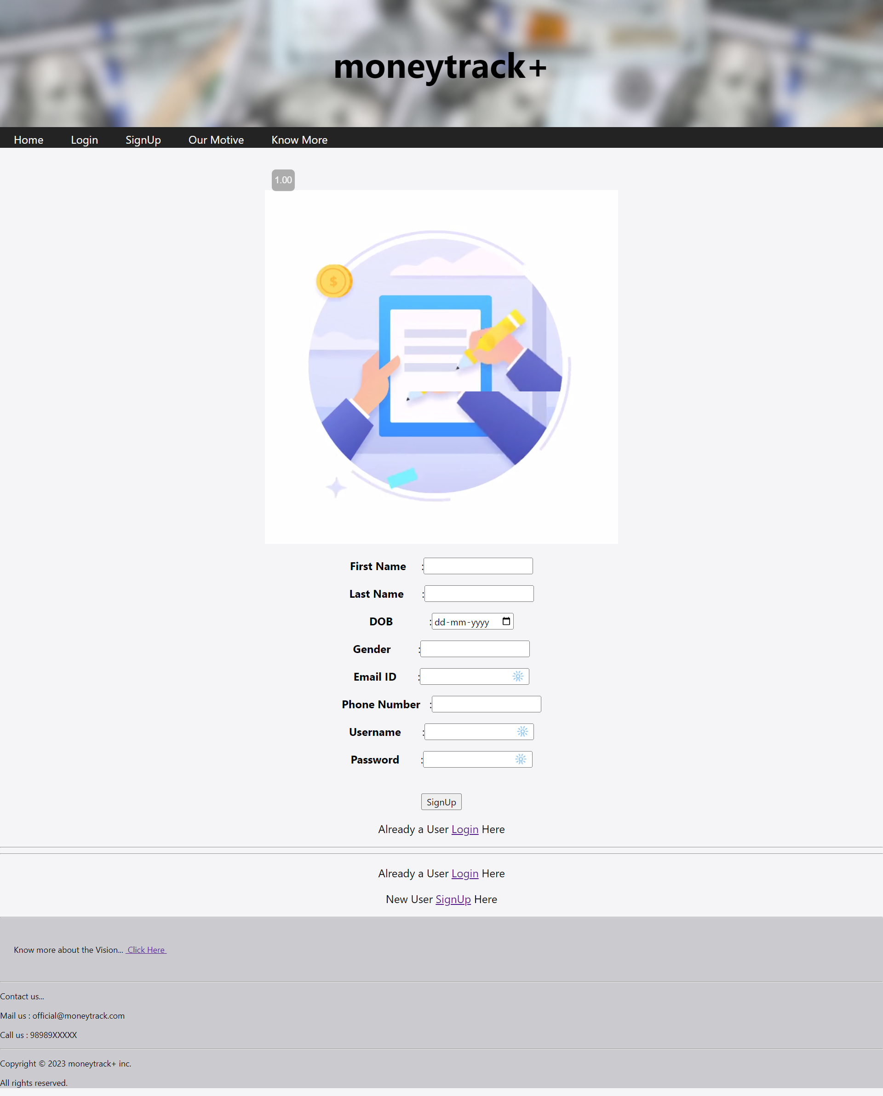
SIGN UP has following tabs:-
At first,we need to sign up in order
to create an account.
In sign up,we need to insert various credentials such as first name,e-mail,phone number,username and our password.

Slide 7
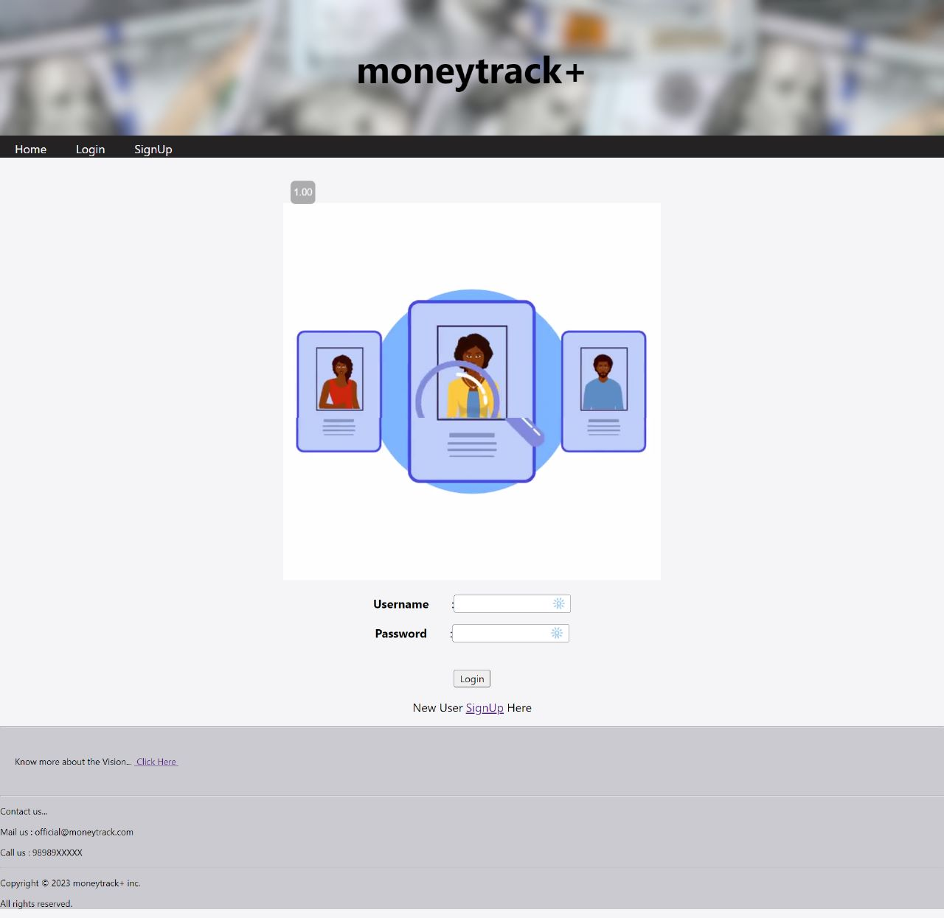
Consequently, the page will direct us to the login page where we need to re-enter our credentials in order to use the main site.

Slide 8
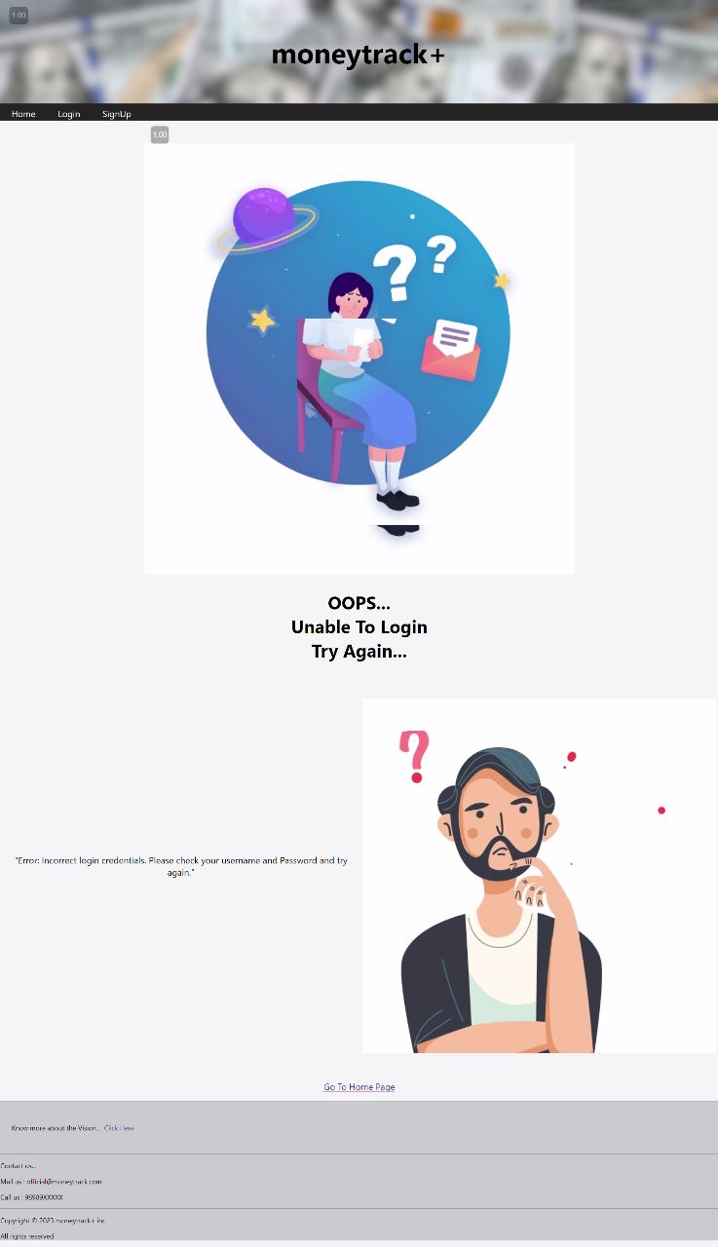
Now,If the credentials are incorrect then the following will be displayed:

Slide 9
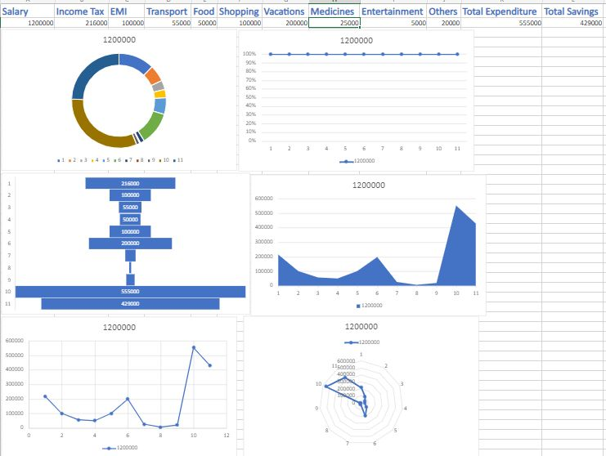
If our credentials are correct then the main site will be loaded.
Our data will be recorded in this form and will also represent in pictorial form.

Slide 10
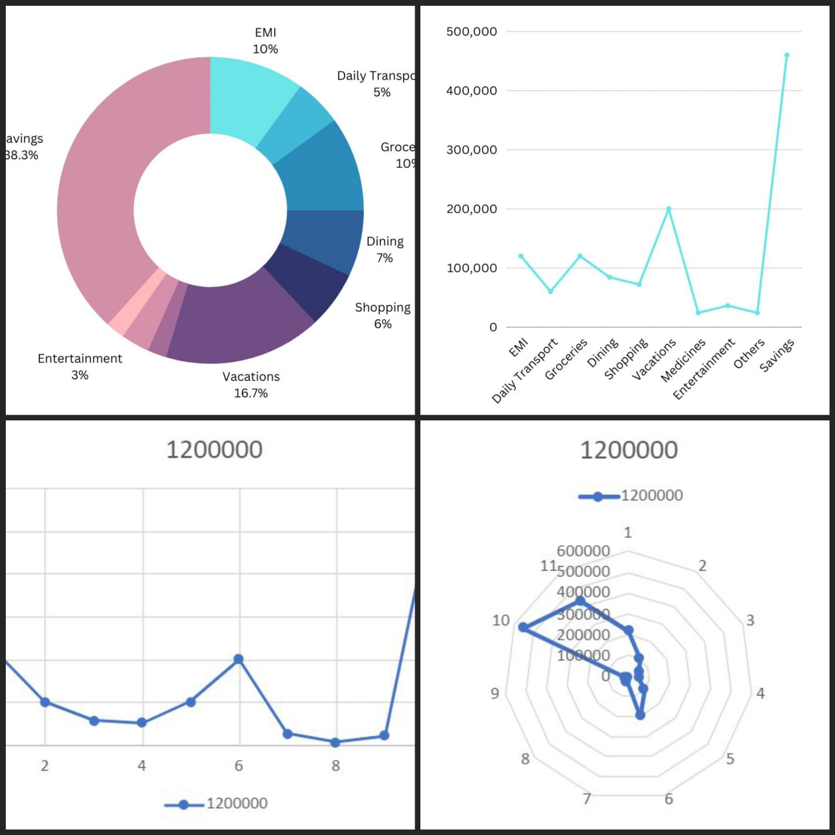
Our data is displayed in various pictorial forms in order to enhance the understanding and readability to the user.

Slide 11
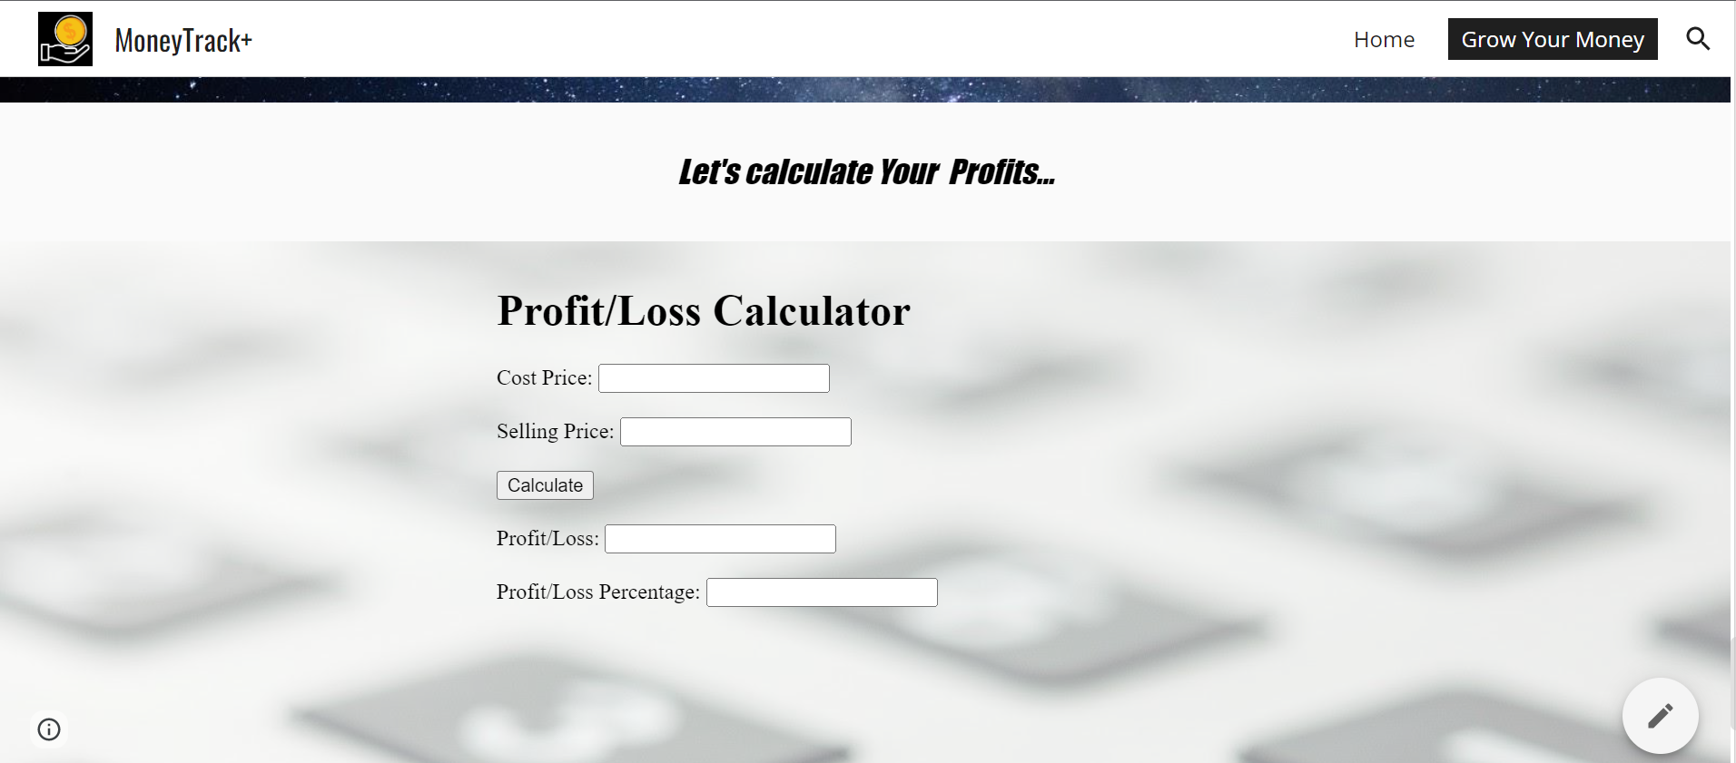
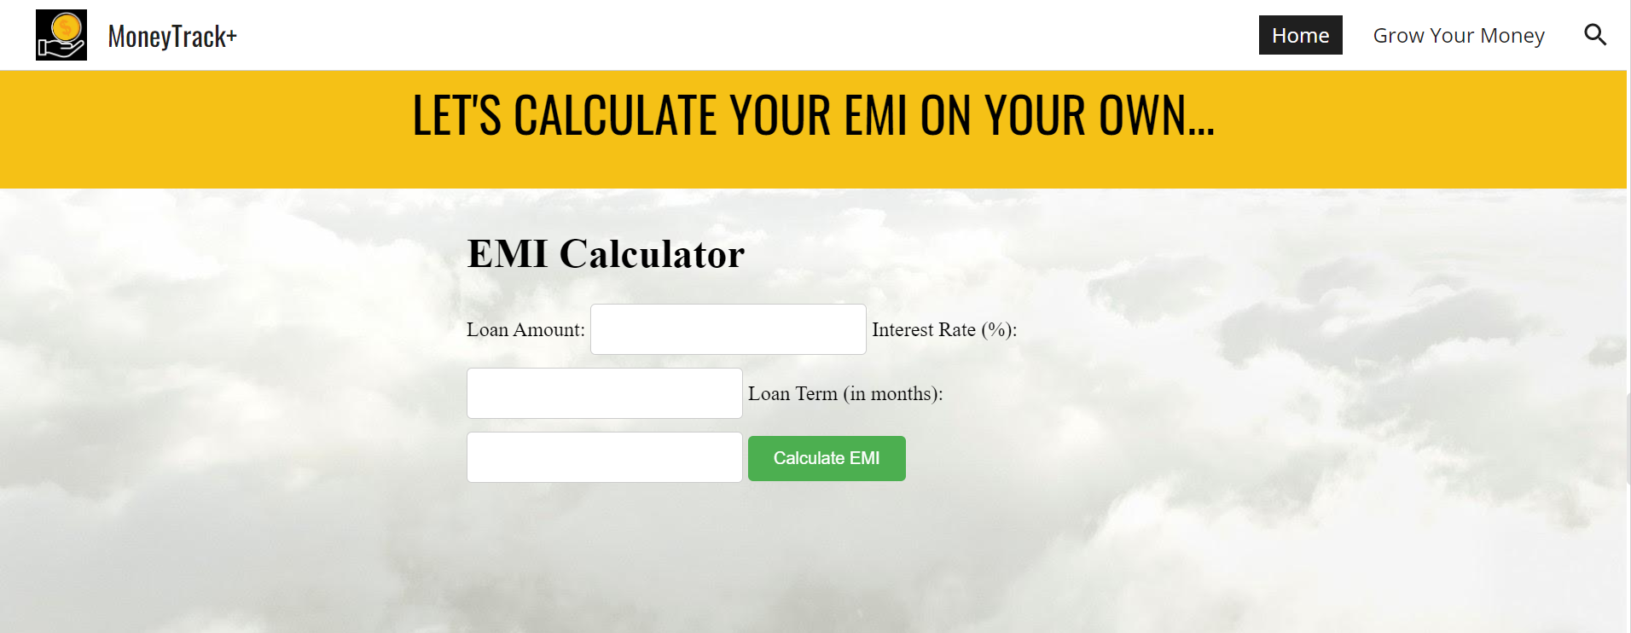
Moreover,we can also calculate Profit/Loss and EMI(Equated Monthly Installment)

Slide 12
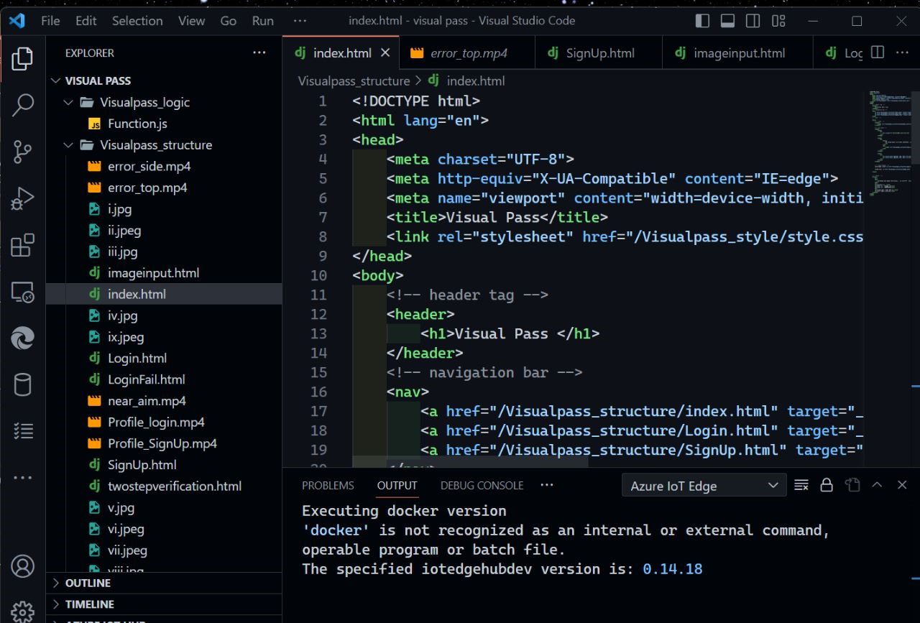

SOME VISUALS OF FRONTEND DEVELOPMENT

Slide 13
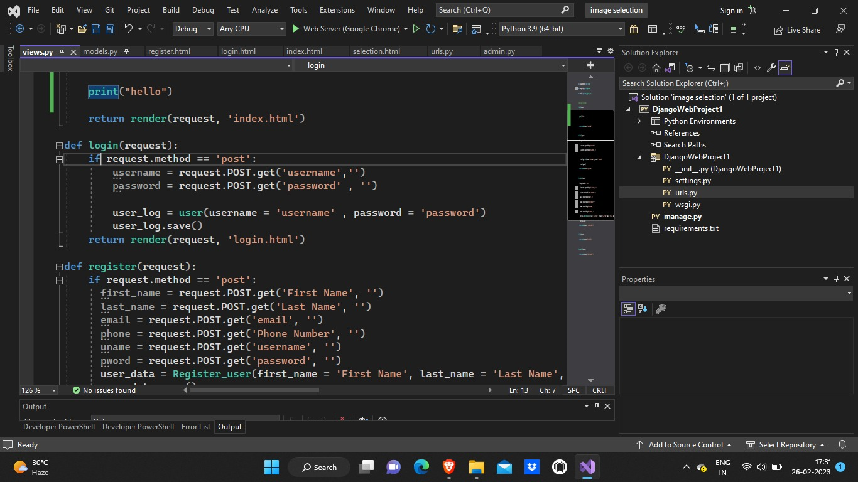
Some visuals of backend development

Slide 14
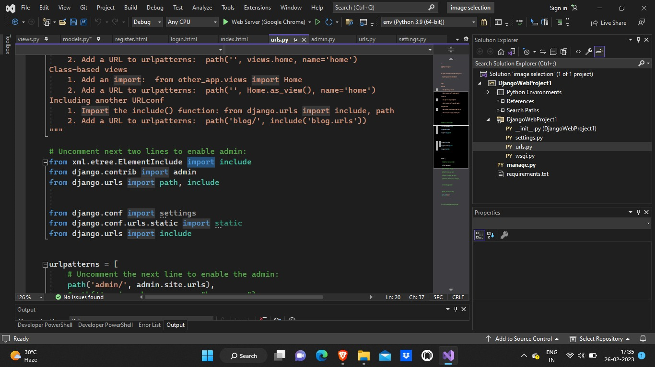
Our team has use different languages like HTML,CSS and Django for this project.

Slide 15
THANK YOU

